Slide 1
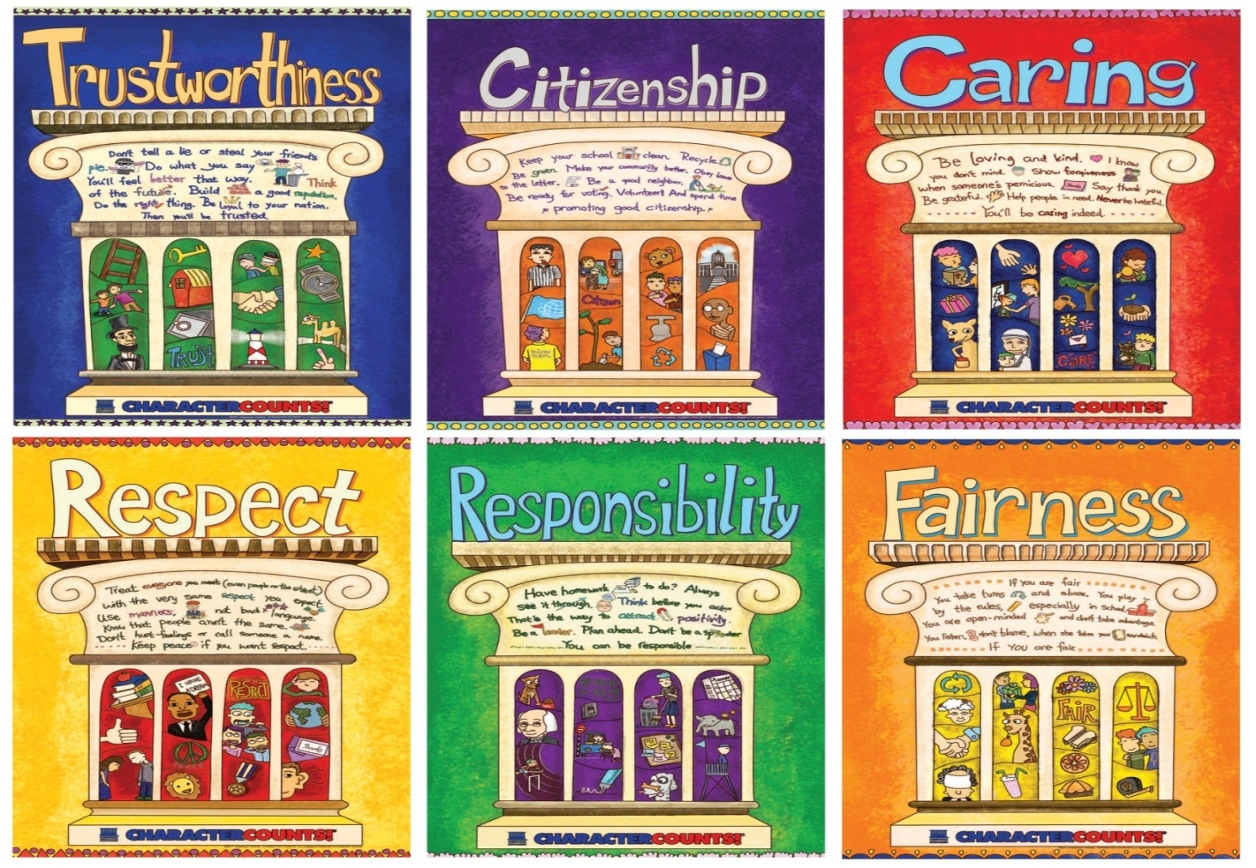
CHARACTER COUNTS! 5.0
Student Development Workshop
Day 2

Slide 2
Opening Activity
Personal Attributes
At the tables you will find papers with descriptive words of personal attributes. What are five attributes that best describe the students you work with? Put a sticker on those five.
Also, identify five personal attributes that you have.
On Worksheet 9, page 29 of your Workbook, answer the following questions related to the personal attributes you see in your students or those you possess:
What is the best way to teach these attributes? Can you think of a way you might integrate this attribute within an academic lesson plan?
What are strategies you could initiate to eliminate the negative attributes?

Slide 3
Ways to Instill Beliefs Day 1
From Day 1, identify the ways beliefs were instilled:
Direct Teaching
Experiential Learning
Vicarious Experiences

Slide 4
Module 8
Values, Ethics and Character
The essence of CHARACTER COUNTS! 5.0 is explicit and overt identification and teaching of the key beliefs (values) that will result in choices that produce desired behaviors.
Notes:
Reinforce use of alternative instructional techniques – video (more memorable and more inspirational)
Vital concept 1: all behavior is the result of choices
Actions are the result of choices
Attitudes are the result of choices
Choices create consequences
Each change in attitude or actions creates different consequences
Vital concept 2: Choices of attitudes and actions are determined by values
Our choices reveal our values

Slide 5
What are they and why do they matter?
Beliefs, attitudes and desires that shape goals and motivate choices
Notes:
Values are essentially beliefs, which, depending on the importance we attach to them , can be described as convictions (usually, these are the most deeply held beliefs evoking passion), attitudes (often reflecting emotions and feelings), opinions and preferences.
A person’s most important beliefs (sometimes different than they think or say) drive behaviors but not always on a conscious level. One of the most effective ways to change behavior is to change beliefs.
Many of our values were formed and reside at a subconscious level , the result of generally held social norms (i.e., culture), religious training, and the teaching and modeling of parents, teachers and peers,
Our values both shape and reflect emotional responses induced at a spontaneous or subconscious level as well as the result of conscious deliberative reasoning.
Most people are unaware of all the beliefs that shape their attitudes and actions.
The beliefs that have the most influence on behavior are not necessarily true. Many are irrational (not the result of reasoning), some are illogical, some are mere superstitions (e.g., if I break a mirror I will have bad luck) and those that relate to objective facts (as opposed to subjective preferences or descriptions of a perception or belief) can be objectively and demonstrably false.

Slide 6
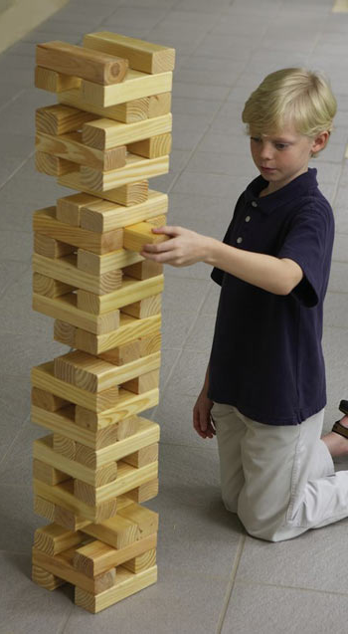
Values are the building blocks of character and shape the nature and quality of our personal and social interactions
Notes:
Point out that the values of the Pillars are the ones that we will be focusing on to help us shape the character of our youth. The behaviors that we can teach according to the Pillars are ones that can also be measured when assessing implementation effectiveness.

Slide 7
A student acts in a way that is consistent with Six Pillars of Character
Behavior
Demonstrates the ability to make a good decision
Choices
The beliefs and attitudes that drive the choices a student makes
Values

Slide 8
What You Need to Know About Values and Choices
The basic precept is that our values shape our choices, which shape our behaviors
We need to believe we can change behaviors and choices, and ultimately values.
All behavior is the result of choices
Choices create consequences
Choices of attitudes and behavior are determined by values
Notes:
Bear in mind that this is instruction that will inform the rest of the course. The basic precept is that our values shape our choices, which shape our behaviors. Our behaviors are reflected ultimately in the areas of the four domains of CHARACTER COUNTS! 5.0. The idea of change theory also helps with this content, for we need to believe we can change behaviors and choices, and ultimately values. More on this later, but set the scene for all of this through introducing values and choices.

Slide 9
Behavior is the result of values, beliefs, mindsets and attitudes that dictate our actions, often at a subconscious level.
We possess many beliefs and attitudes that we did not choose – they were instilled by parents or other social and cultural forces and adopted without much reflection.

Slide 10
Our attitudes and mindsets affect our actions and reactions.
We may not choose our immediate emotional reaction or initial attitude, but we can choose to hold on to or change how we react to or feel about a situation.

Slide 11
How are values instilled or adopted?
Instruction:
Direct teaching and advocacy concerning what is right, desirable and effective
Emulation:
Adoption of attitudes and beliefs of others (i.e., role models)
Habituation:
Inculcation of automatic patterns of thinking and being

Slide 12
Methods of teaching/instilling beliefs that will produce desired behaviors
Explanation
(didactic lecture)
Experiential activity
generates self-discovery and an emotional commitment to desired beliefs and behavior
Vicarious experience
Stories told orally, by book, video or movie
Notes:
Make reference here to the strategies that have been used thus far in the course, following these three components.

Slide 13
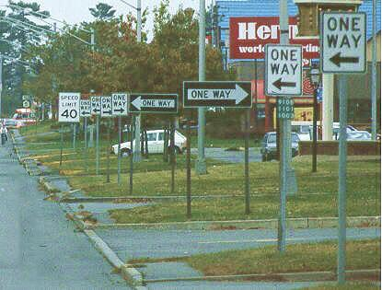
Children today are forming their values and character in a world full of inconsistent messages
Notes:
13
Make reference to the inconsistent messages that children are hearing. For example, it’s important to pass exams, but test results aren’t everything. Watching others, particularly celebrities, flaunt and sometimes break the law with little or no recourse, yet the youth are expected to follow the rules. Or closer to home, they are expected to hand in homework on time and be ready at school, but sometimes the teachers themselves are tardy in returning work to the students. Here it is important to refer to Modeling, the M in TEAM.

Slide 14
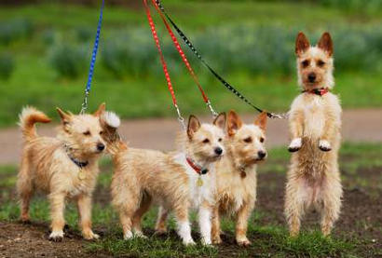
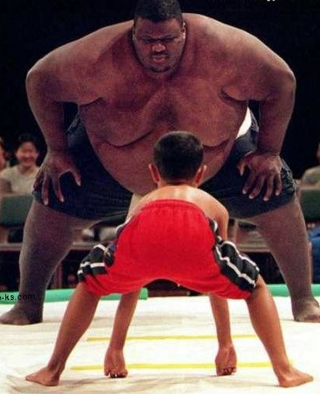
Our values tell us what we stand for
And what we are willing to fight for
Notes:
Sometimes we have to do the right thing even when it costs more than we want to pay. This is a key concept of the culture of kindness material in terms of the responsibilities of bystanders.

Slide 15
Values Video
Concert
Notes:
Video clip on www.values.com TV Spot

Slide 16
Values Video
Natalie Gilbert & Mo Cheeks
Notes:
https://www.youtube.com/watch?v=Sin9M9boANo

Slide 17
Values Video
Locker
Worksheet 10, page 31
Notes:
WWW.values.com TV Spot

Slide 18
Ethical values help us sort through conflicting messages and tell us the right way to go.
“Decisions are easy when you know your values.”
- Roy Disney

Slide 19
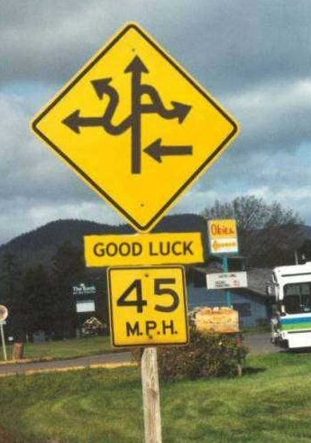
Without a clear set of values, inconsistent messages make life confusing

Slide 20
Stated Values
Operational Values
What we say we value and the level of importance we say we attach to the value
What we actually value – our highest priorities revealed by our actions and choices
Notes:
20
Stated Values and Operational Values

Slide 21
You do not learn how to ride a bicycle by looking at pictures of bicycles in a book and studying laws of physics. You learn how to ride a bicycle by getting on a bike and riding. - Barbara Lewis
Similarly, you learn to be a good person by the choices you make. Your actions are the result of putting what it is you value into practice.
21

Slide 22
Instrumental Values
Intrinsic Values
Beliefs about feelings and achievements that are intrinsically good and worthy as end states (not merely means to an end); they define ultimate goals.
Beliefs about what is important to achieve other goals or outcomes. These are intermediate values; means to an end.
Notes:
22
Intrinsic and instrumental values.
Beliefs about feelings and achievements that are intrinsically good and worthy as end states (not merely means to an end); they define ultimate goals.
Beliefs about what is important to achieve other goals or outcomes. These are intermediate values, means to an end.

Slide 23
Nonethical Values
Beliefs about what is effective, desirable or pleasurable without reference to the moral quality of the result; nonethical values are ethically neutral.
Ethical Values
Beliefs about what is right and good based on moral duty and virtue; beliefs about what traits of character and ways of being are morally right and good
Nonethical Values
Work EDUCATION Art & Music
Intelligence Sense of Humor WEALTH/POSSESSIONS
Independence Growth STATUS Harmony
Challenge APPROVAL Leisure Time
Ethical Values
6 Universal Ethical Values
TRUSTWORTHINESS RESPECT
RESPONSIBILITY FAIRNESS
CARING CITIZENSHIP
RELIGIOUS BELIEFS Lifestyle Choices Thrift
Premarital sex Adultery Homosexuality
Gambling Euthanasia ABORTION
FAMILY Capital punishment Drugs Drinking
Cultural and Personal
Ethical Values
Notes:
Point out difference between ethical and non-ethical values. The ones we are concerned with fall in the concepts of the Six Pillars. Again highlight the universality of these.

Slide 24
Review about Values
How is an ethical value different from a regular value?
How is a value different than a regular belief?
What is the difference between a stated value and an operational value?
What is the difference between an instrumental value and an intrinsic value?
Worksheet 11 - Page 32

Slide 25
What is Character?
Notes:
25

Slide 26
Aspen Declaration
The next generation will be the stewards of our communities, nation, and planet in extraordinarily critical times.
The present and future well-being of our society requires an involved, caring citizenry with good moral character.
People do not automatically develop good moral character; therefore, conscientious efforts must be made to instruct young people in the values and abilities necessary for moral decision making and conduct.
Effective character education is based on core ethical values rooted in democratic society, in particular, trustworthiness, respect, responsibility, fairness, caring, and citizenship.
One
Two
Three
Four

Slide 27
Aspen Declaration
These core ethical values transcend cultural, religious, and socioeconomic differences.
Character education is, first and foremost, an obligation of families and faith communities, but schools and youth-service organizations also have a responsibility to develop the character of young people.
Seven
The character and conduct of our youth reflect the character and conduct of society; therefore, every adult has the responsibility to teach and model the core ethical values, and every social institution has the responsibility to promote the development of good character.
Five
Six
These responsibilities are best achieved when these groups work in concert.
Eight

Slide 28
What is Character?
1.
Character is ethics in action.
2.
Character is the moral strength to do the right thing even if it costs more than you want to pay.
3.
Character is how you behave when no one is looking.
4.
Character is the sum total of a person’s traits and qualities.

Slide 29
Responsibility for Character
Students understand that their character is a product of their values and choices (i.e., the formation of their character lies in their own hands).
Students accept and demonstrate personal responsibility to create and improve their character by conscientious efforts to strengthen their commitment and adherence to ethical values and principles.

Slide 30
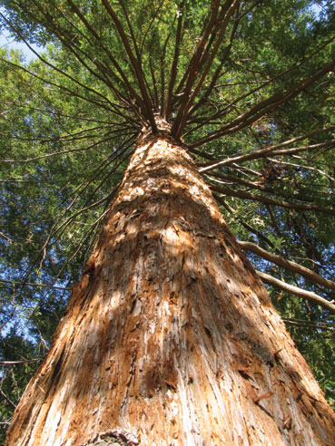
Character and Reputation
“Our reputation is what other people think we are; character is what we really are.” John Wooden
Lincoln said our character is the tree; our reputation the shadow.
Notes:
30

Slide 31
Write a slogan that speaks clearly as to what is character
Activity - Page 33

Slide 32
CHARACTER
C1. COMMITMENT TO CHARACTER AND ETHICS. Students understand the personal and social importance and the basic terminology and concepts of character and ethics. They strive to acquire the knowledge, adopt the values, and develop the skills, traits, and conduct patterns of a person of good character, and they seek to govern their choices and actions by universal moral/ethical principles.
C1.1. Good Character – Components
C1.2. Importance of Character
C1.3. Responsibility for Character
C1.4. Six Pillars of Character
C1.5. Ethical Concepts and Terms
Notes:
Refer participants to the Matrix

Slide 33
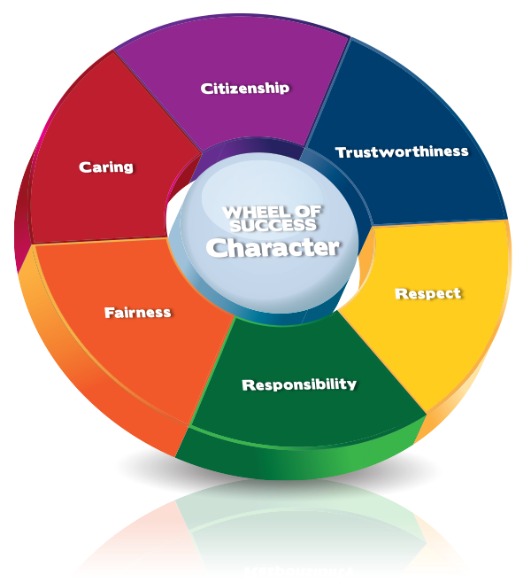

Slide 34
MODULE 9
Strategies to instill the Six Pillars of Character
T
TRUSTWORTHINESS
R
RESPECT
R
FAIRNESS
F
RESPONSIBILITY
C
C
CARING
CITIZENSHIP
Notes:
TEACHING THE SIX Pillars:
Have participants turn to the “Pillar Integration Handout” in their workbooks. Under each pillar is a box for key beliefs participants will fill out. There is also a section for the participants to identify specific strategies to TEAM the Pillar. These handouts should be used throughout the discussion for each of The Six Pillars. Allow participants time at the end of each module to fill out the handout for the pillar covered.

Slide 35
Six Pillar Poster Activity
Words
Symbols
Materials: Pillar Posters /1 piece of wall chart paper
Step 1: Divide wall chart paper in half. On one side list the words or phrases that represent your Pillar; on the other side list or draw symbols that represent your Pillar.
Step 3: List an instructional strategy you could use to instill each of the “key beliefs.”
Step 2: Using the words and symbols, write “lock beliefs” that can be changed into “key beliefs” for students. Consider each of the Wheels of Success: Academic, Social/Emotional, Character, Climate.

Slide 36
Create a Six Pillar Commercial
Using what you learned from the Six Pillar Poster Activity, pick out the most significant aspects of your Pillar.
As a Pillar Team, please create a “commercial” no longer than 2 minutes to “sell” the value.
You may use material(s) in the room.
All members of the group must participate.
You may practice in any space where your team can work effectively together.

Slide 37
CHARACTER COUNTS! 5.0
In the Training Workbook, there is a worksheet for you to use in identifying strategies to:
“Teach” / “Enforce” / “Advocate” / “Model” each of the Pillars

Slide 38
C2. TRUSTWORTHINESS
Students recognize both the moral and practical significance of trustworthiness as an essential ingredient in meaningful and lasting relationships and career success. They strive to earn and maintain the trust of others by consistently demonstrating the ethical virtues of integrity, honesty, promise-keeping and loyalty.

Slide 39
Aspects of Trustworthiness
C2.1. Integrity
C2.2. Honest Communications
C2.3. Honest Actions
C2.4. Belief That Honesty Pays
C2.5. Promise-Keeping & Reliability
C2.6. Loyalty

Slide 40
TRUSTWORTHINESS
I will be a better student if I act on the following beliefs:
Trust is essential to all of my important relationships.
Honesty is the best policy.
I should keep my promises.
It’s not worth it to lie or cheat because it hurts my character.

Slide 41
TRUSTWORTHINESS
 | Elementary | Secondary
Key Questions | What is trust? How can I be honest when talking with others? | Why is it important to have trustworthy relationships? What is integrity? What are the key elements of trustworthiness?
Supporting Questions | Who is important to me? What is right and wrong? Whom do I trust? Should I trust everybody? When I make a mistake, what should I do? | What does it mean to trust others? How can I be dependable? Why is it important to be consistent? When trust is broken or absent, what are the results? Can trust be repaired?
Key Concepts | Honesty, integrity, promise-keeping, loyalty
Notes:
As you go through the final slide, point out that these essential questions are in their workbooks and are from the Connect With Character user’s guide.
The questions act as instructional guides. When students have understood the concepts of trustworthiness the questions will help them construct the knowledge learned and apply it to their everyday lives.
There is slide for each of the Pillars.

Slide 42
Notes:
Show the following clips consecutively
Honesty
“Bagger Vance”
“Liar Liar”
Divide participants into groups of 3 (or use the Appointment Clock) to discuss the following questions and take notes in their workbooks, page 26 on the Trustworthiness Videos page:
What values are found in each clip?
Were you surprised as to the choices made?
What did you think could have happened?
Why didn’t it happen that way?
What choice was being made even if no one needed to know?

Slide 43
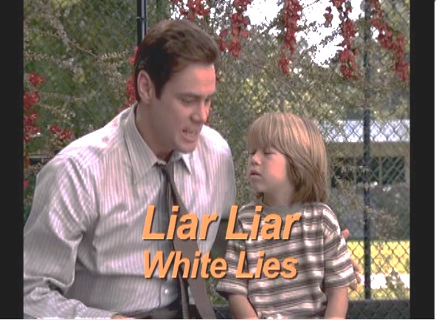
Notes:
Show the following clips consecutively
Honesty
“Bagger Vance”
“Liar Liar”
Divide participants into groups of 3 (or use the Appointment Clock) to discuss the following questions and take notes in their workbooks, page 26 on the Trustworthiness Videos page:
What values are found in each clip?
Were you surprised as to the choices made?
What did you think could have happened?
Why didn’t it happen that way?
What choice was being made even if no one needed to know?

Slide 44
White lies often look very different from the perspective of the person lied to.
Thank you for caring.
So, what else have you lied to me about?!
THE TEST:
Upon learning of the lie, would the person you lied to thank you for caring? Or feel manipulated or betrayed?

Slide 45
Using the Pillar integration handout on page 36 of your workbook and the Matrix in the Character Domain, reflect on how you can intentionally teach, enforce, advocate, and model the Pillar of Trustworthiness.
The process to integrate CHARACTER COUNTS is T.E.A.M. (Teach, Enforce, Advocate, Model)
Creating an ethical climate through integration

Slide 46
C3. RESPECT
Students treat every individual with respect and judge others on their character and ability without regard to race, religion, sexual orientation, political ideology, gender, age, or other physical or personal characteristics based on the belief that all individuals are worthy and that their well-being and dignity is important simply because they are fellow human beings.

Slide 47
RESPECT
C3.1. Treating Others With Respect
C3.2. Golden Rule
C3.3. Basics of Respect
C3.4. School Climate
C3.5. Respecting Privacy
C3.6. Respecting Others’ Autonomy

Slide 48
RESPECT
I will be a better student if I act on the following beliefs:
I should be courteous and have good manners.
I should live by the Golden Rule: Treat others the way I want to be treated.
Avoid being a bully or fighting with others.
Treat everyone the same whether they are my friend or someone I don’t know very well.

Slide 49
RESPECT
 | Elementary | Secondary
Key Questions | What is respect and self-respect? How can I respect myself and others? | How can I live by the Golden Rule? How can I gain respect? What do tolerance and the autonomy of others mean?
Supporting Questions | How do I treat others? How can I know if what I do makes others happy? What can I do to treat others the way I’d like to be treated? How do others feel? | What are the actions of respectful people? How can I show respect and be respectful? What does it mean to be tolerant of those who are different? What choices do I have to develop and maintain self-respect?
Key Concepts | The Golden Rule, civility, courtesy, accepting differences, anti-bullying

Slide 50
Universality of the Golden Rule
Confucius:
Aristotle:
Judaism:
Hinduism:
Islam:
Buddhism:
Christianity:
What you do not want done to yourself, do not do unto others.
We should behave to others as we wish others to behave to us.
What you dislike for yourself, do not do to anyone.
Do nothing to thy neighbor which thou wouldst not have him do to thee thereafter.
No one of you is a believer unless he loves for his brother what he loves for himself.
Hurt not others with that which pains thyself.
Do unto others as you would have them do unto you.

Slide 51
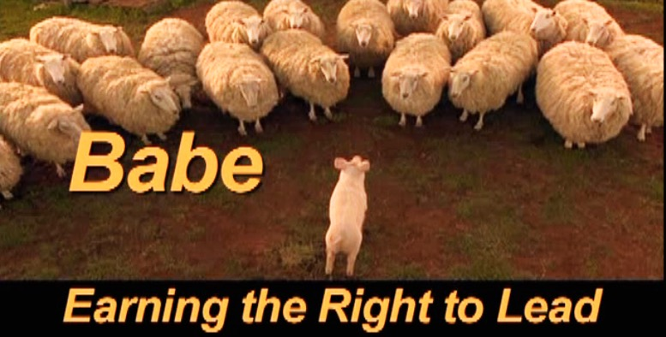

Slide 52
Using the Pillar integration handout on page 38 of your workbook and the matrix in the Character Domain, reflect on how you can intentionally teach, enforce, advocate, and model the Pillar of Respect.
The process to integrate CHARACTER COUNTS is T.E.A.M. (Teach, Enforce, Advocate, Model)
Creating an ethical climate through integration

Slide 53
C3. RESPONSIBILITY
Students display responsibility by: doing what they are required to do and what they should do; accepting responsibility for the consequences (i.e., being accountable) for what they say, do and think; and using critical thinking (A4) and decision-making (A5) skills to avoid rationalizations and excuses and make rational, prudent choices.

Slide 54
RESPONSIBILITY
C4.1. Compliance: Doing What Is Required
C4.2. Ethics: Doing What Should Be Done
C4.3. Consequences for Their Words
C4.4. Consequences for Actions
C4.5. Developing and Using Positive Attitudes and Life Skills
C4.6. Self-Reliance and Prudent Money Management
C4.7. Learning From Experience
C4.8. Being Rational and Reflective
C4.9. Healthy Choices

Slide 55
RESPONSIBILITY
I will be a better student if I act on the following beliefs:
I need to hold myself and others accountable for the consequences of words, actions and inactions.
I should exercise self-control and set a good example.
It is important to plan, set goals, and persist in order to be successful.
I should do what I have to do without whining or giving excuses.
I should do my best work and be my best self.

Slide 56
RESPONSIBILITY
 | Elementary | Secondary
Key Questions | What are my responsibilities? How do our responsibilities to others help us live well together? | How can we share responsibilities and be effective? What are my long-term and short-term goals? What can I do to understand my abilities and limitations?
Supporting Questions | What tasks am I expected to do? Why do I have to do things? What would happen if I didn’t do some things? How can I manage my responsibilities? | How can I develop my self-control? What can I learn from others? How can I prioritize my responsibilities? How can I develop good self-assessment skills? What can I learn from others? Do I have a sense of self-control over my behavior?
Key Concepts | Duty, accountability, pursuing excellence, exercising self-control, planning, goal-setting

Slide 57
Video - Lateefah Simon
Activity - Page 40
Notes:
Show the video and direct participants to complete the relevant page in their workbooks.
As they watch the video, tell them to respond to the questions.
How did the story make you feel?
What did you learn from it?
What Pillars did you see in her story?
How did she handle making decisions?
My future is up to me? Do you agree?
How does being responsible give you power?
Debrief on the video.

Slide 58
Responsibility and Character Development
You can’t choose to be good-looking, athletic, or a genius. You can’t choose your parents or the circumstances in which you grow up.
But you can choose how to deal with the outrages and opportunities of life.
From these choices, your character is formed.
Notes:
Life is full of choices. Responsibility requires we accept:
the moral obligation to choose attitudes, words, and actions
the duty to accept personal responsibility for the consequences of those actions.

Slide 59
Using the Pillar integration handout on page 41 of your workbook and the matrix in the Character Domain, reflect on how you can intentionally teach, enforce, advocate, and model the Pillar of Responsibility.
The process to integrate CHARACTER COUNTS is T.E.A.M. (Teach, Enforce, Advocate, Model)
Creating an ethical climate through integration

Slide 60
C5. FAIRNESS
Students strive to be fair and just in all their actions by 1) taking turns; 2) playing by the rules; 3) giving due credit to others; 4) asking for and taking only their fair share (i.e., what is due them). They never 1) cheat; 2) claim credit for the work of others; 3) recklessly or falsely blame or accuse others; or 4) take advantage of another’s mistakes or ignorance (even when they think they can get away with it or that the other person deserves it).

Slide 61
FAIRNESS
C5. Fairness. Students strive to be fair and just in all their actions
C5.1. The Basics of Fairness
C5.2. Making Fair Decisions
C5.3. Proportionality
C5.4. Complexity of Fairness

Slide 62
FAIRNESS
I will be a better student if I act on the following beliefs:
Treat all people equitably based on their merits and abilities.
Accept the fact that something is not unfair just because I didn’t get what I wanted.
Willingly take turns and share with others.
Understand the importance of rules to define games, establish order and common expectations.

Slide 63
FAIRNESS
 | Elementary | Secondary
Key Questions | What is fair and unfair? How can I learn to make fair decisions? | What do fairness and justice represent? How can I avoid being unfair? What moral obligations are involved in fairness and unfairness?
Supporting Questions | Why is it important to play fairly and to share? What can I do to play fairly? What does fairness mean to me? How can I put into practice fair decision-making? | What do fairness and justice mean to me? How can I accept fairness when it means I don’t get what I want? What course of action should I take when I see something unfair? What and who will be affected by my being unfair? What is a moral obligation?
Key Concepts | Justice, equity, equality, openness, impartiality, consistency

Slide 64
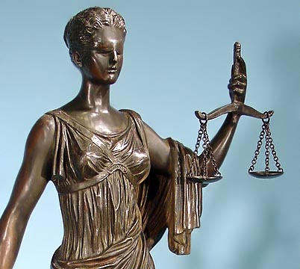
Process – How we make decisions.
The moral obligation is to make decisions fairly. This is called procedural fairness.
Results – What we decide (the substance of the decision). The consequences or benefits should be fair.
The moral obligation is to make fair decisions. This is called substantive fairness.
Notes:
(Fairness). Be consistent, open, and treat all people equitably. Consider all sides and make decisions on the facts without favoritism or prejudice. Play by the rules, avoid careless accusations, don’t take undue advantage of others. Pursue justice and condemn injustice.

Slide 65
Procedural Fairness Requires...
Gathering of the facts
Fair hearing
Fairness
Fair Notice
Impartiality
Procedural

Slide 66
There are five major alternative theories of fairness
1) Equality –everyone should get equal shares regardless of other factors
2) Work – only those who worked should receive benefits
3) Effort – shares should be allocated in proportion to effort
4) Seniority – benefits should be distributed in order of age or seniority
5) Productivity – benefits should be distributed in proportion to the productivity of the person

Slide 67
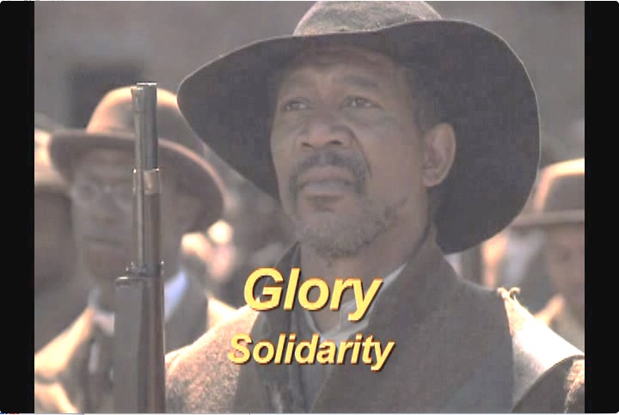

Slide 68
Using the Pillar integration handout on page 43 of your workbook and the matrix in the Character Domain, reflect on how you can intentionally teach, enforce, advocate, and model the Pillar of Fairness.
The process to integrate CHARACTER COUNTS is T.E.A.M. (Teach, Enforce, Advocate, Model)
Creating an ethical climate through integration

Slide 69
C6. CARING
Students demonstrate caring by: 1) displaying sincere concern for the well-being of others; 2) displaying compassion for those in pain or need; 3) being kind and sympathetic to everyone (even those who don’t seem worthy of kindness); 4) giving time, service and money to charitable organizations and individuals to help those in need.

Slide 70
CARING
C6.1. The Basics of Caring
C6.2. Caring & Other Ethical Duties
Caring Moderates Other Ethical Duties. Students understand the virtue of caring frequently interacts with other ethical principles requiring them to be careful that:
Honesty is not causing them to be unnecessarily hurtful or offensively blunt.
In seeking to impose justice, they do not miss opportunities to be merciful and forgiving.
While respecting another’s privacy, they do not condone or ignore dangerous and harmful conduct.
Their sense of responsibility is proportionate to their actual level of authority and moral duty and that they do not ignore their own needs..

Slide 71
CARING
I will be a better student if I act on the following beliefs:
I have to show concern for others’ well-being.
I should act compassionately and with empathy.
I need to be kind and considerate.
I have to be willing to show mercy and forgiveness.

Slide 72
CARING
 | Elementary | Secondary
Key Questions | How can I show I care? How can I develop empathy? | How can I become more altruistic? How can I learn forgiveness? How can I show conviction for and commitment to being a caring person?
Supporting Questions | What does caring mean? How can I care for my friends? Who cares for me? How can I show caring? What happens when I hurt someone? How do I feel when I am hurt by someone? | How do I feel when someone helps me? What should I think about when others need help? What should I do when someone hurts me? How can I avoid hurting others? What can I learn from people who’ve forgiven me for mistakes I’ve made? How can I teach others to be more caring?
Key Concepts | Concern for others, kindness, compassion, love, charity, empathy, mercy, forgiveness

Slide 73
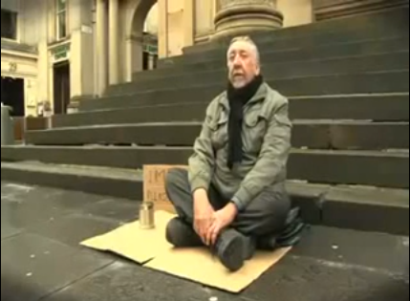
Change Your Words
Notes:
https://www.youtube.com/watch?v=Hzgzim5m7oU
Have participants view the videos and take notes in the relevant pages in their workbooks.
Debrief as a whole class, asking a couple of volunteers to give their responses to the questions: How do the videos make you feel?
What values are evident in the videos?
What did you learn from it? What are the target values we want to see around the pillar of caring? What are the beliefs we want to instill in student? What do we want to eliminate?

Slide 74
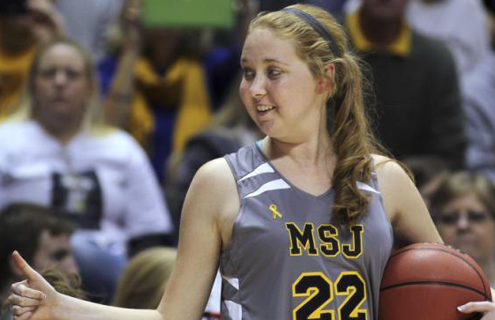
Lauren Hill’s dreams come true – November 2014
Hiram College- the other side of the story

Slide 75
Caring Video
Lauren Hill

Slide 76
On April 10, 2015, Lauren died at age 19 after her battle with brain cancer

Slide 77
Caring Video
Lauren Hill – Never Give Up

Slide 78
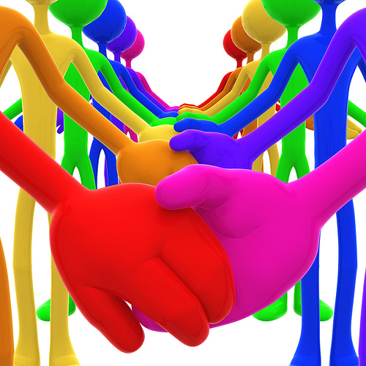
Creating a Culture of Kindness
A Culture of Kindness exists when the climate of a place promotes kindness and discourages unkind thoughts and actions.
Empathy, compassion, caring and respect are expected and their opposites are out of place.
Notes:
Follow slide content.

Slide 79
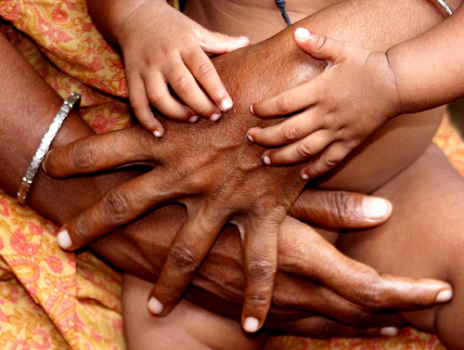
Creating a Culture of Kindness
In a Culture of Kindness, all social incentives encourage and affirm a spirit of generosity and love and discourage all forms of hurtful or demeaning words or acts.
In a Culture of Kindness, everyone feels at home.
Notes:
Each member of the community is aware of and understand empathetic behavior. They do not stand for mean or cruel behaviors and act quickly to remedy the situation. Bystanders know their role, and strategies are provided for the targets of bullying behaviors.
Bullying behaviors are different from good natured teasing. The difference is when the teasing becomes hurtful or distressful, it stops.

Slide 80
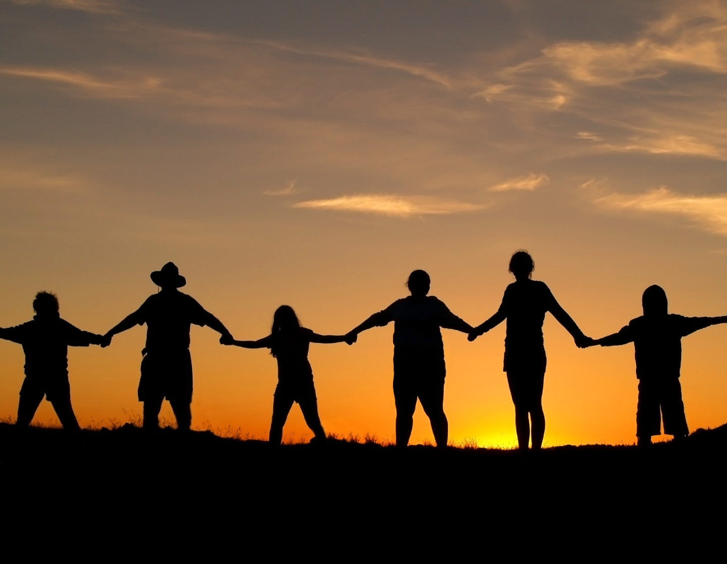
Creating a Culture of Kindness
In a Culture of Kindness, differences are accepted and celebrated.
In a Culture of Kindness, it’s all for one and one for all; people stand up for and next to each other.
Notes:
In the workshop there are components that deal with respecting differences and role plays.
The matrices in the workbook participants have demonstrate the behaviors that are acceptable and the course of action that should be taken if bullying behaviors are evident.

Slide 81
Using the Pillar integration handout on page 50 of your workbook and the matrix in the Character Domain, reflect on how you can intentionally teach, enforce, advocate, and model the Pillar of Caring.
The process to integrate CHARACTER COUNTS is T.E.A.M. (Teach, Enforce, Advocate, Model)
Creating an ethical climate through integration

Slide 82
C7. CITIZENSHIP
Students recognize and seek to fulfill their civic and social responsibilities by doing their share to contribute to the well-being of the communities in which they are a member (including their school, neighborhood and country).

Slide 83
CITIZENSHIP
C7.1. Civil Rights
C7.2. Civil Responsibilities
C7.3 Respect for Authority & Law
C7.4. Participation in Democratic Process
C7.5. Improving School Climate
C7.6. Environmental Protection

Slide 84
CITIZENSHIP
I will be a better student if I act on the following beliefs:
I will play by the rules.
I need to obey the law.
I should do my share in my family, class, school and community.
I recognize my duty to protect and improve the environments in which I live.

Slide 85
CITIZENSHIP
 | Elementary | Secondary
Key Questions | What does it mean to be a good citizen? What are rules? | What are my civic duties? How do I enact and protect democratic values?
Supporting Questions | Why do we have rules? How can I help? Why should I do my share? What does it mean to be a good neighbor? | What communities do I belong to? How can I make a difference? What is the common good? What are the values of my communities? How can I participate actively for the collective benefit of communities? When is civil disobedience appropriate? How can I be an advocate for a cause?
Key Concepts | Playing by the rules, Being a good citizen, Sharing

Slide 86
Citizenship Video
Lead India Video - Tum Chalo
Notes:
Show the “Lead India” clip. https://www.youtube.com/watch?v=JR8i9p3pcPg
Have the participants consider the meaning behind the video. How might it relate to Citizenship? What message can they take from it to inform their own lives? How can it be used to influence the lives of their students? Their communities and businesses?
Translation:
Hold the sky to stand, and walk with the wind in your hands,
Be the front-runner; because when you walk, Hindustan (India) walks with you.
Lend your hand to pull out the Sun in the morning,
Fill your hands with sunlight, and throw it around,
Keep you legs on the horizon, and walk with pride,
Hold the sky to stand, and walk with the wind in your hands
Be the front-runner; because when you walk, Hindustan (India) walks with you.

Slide 87
Create an ad campaign to promote a Culture of Kindness to show we care about each other
Slogan for the campaign
Write at least 2 action items that would help to promote the Culture of Kindness campaign
Activity - Page 52

Slide 88
Using the Pillar integration handout on page 53 of your workbook and the matrix in the Character Domain, reflect on how you can intentionally teach, enforce, advocate, and model the Pillar of Citizenship
Creating an ethical climate through integration
Share three specific ways to Teach, Enforce, Advocate, and Model the Pillars.

Slide 89
Using the Matrix of Critical Educational Outcomes, Key Beliefs and Instructional Strategies
Turn to the Matrix for Social/Emotional Wheel of Success pages 9-18. There you will find 52 instructional strategies designed to instill the key beliefs.
Self-Awareness
Positive Life Skills & Attitudes
Self-Management Skills
Social & Relationship Skills
WHEEL OF SUCCESS Social/Emotional

Slide 90
How You Can Promote CHARACTER COUNTS! In Your School
Part 1: As an individual:
Circle at least 5 instructional strategies associated with key beliefs in the Social/Emotional Wheel of Success that you already do.
Underline at least 5 instructional strategies you’d like to try.
Star three instructional strategies that if successfully implemented would make a measurable difference in your class or school.
Part 2: As a group:
Each share two strategies circled, two strategies underlined and one strategy starred.
For each idea shared, determine if this reflects T – teaching E – enforcing A – advocating M- modeling.
Part 3: Reporting out:
What conclusions can we draw from this activity?
Share from your group one strategy someone is already doing; one strategy someone would like to try; one strategy that would make a measurable difference.
Activity - Page 54

Slide 91
Write words or symbols that best describe your assigned trait.
Draw symbols that best describe your assigned trait.
Social-Emotional Trait __________
What are locks and keys associated with your words or symbols?
What can you do in your classroom to teach your trait?

Slide 92
Module 10
Taking Choices Seriously
Exemplary Decision Making

Slide 93
The quality of our lives and the success of our efforts in both our personal and professional lives will be determined by our choices.

Slide 94
Your life is the sum result of all the choices you make, both consciously and subconsciously. If you can control the process of choosing, you can take control of all aspects of your life. You can find the freedom that comes form being in charge of yourself.
⎯ U.S. Senator Robert F. Bennett, a member of a bi-partisan CHARACTER COUNTS! Working Group in the Senate

Slide 95
We are Morally Accountable for Our Choices
All that is necessary for evil to triumph is for good men to do nothing.
– Edmund Burke
It is true I am only one. But I am one. And the fact that I cannot do everything will not prevent me from doing what I can do. –Edward Hale

Slide 96
Every Decision Sends a Message
In addition to the immediate and long term affects of a decision on our own lives, every decision we make sends a message to the world as to what we value and what kind of people we are.
Thus, we should always consider the potential impact of our choices on our reputation and credibility.

Slide 97
Two Core Principles for Good Decision Making
We have the power to decide what we think, say and do.
We’re morally responsible for the consequences of our choices.

Slide 98
Actions are the result of choices
Attitudes are the result of choices
Choices create consequences
Each change in attitude or actions creates different consequences
Good choices create good consequences

Slide 99
Good choices produce good results.
Better choices create better results.
The best choices produce the BEST POSSIBLE RESULT.

Slide 100
What We Need to Teach Children and Young People
Decision-Making
To think of all choices in terms of potential consequences to themselves and to others (stakeholders)
Every decision has consequences
The greater the potential consequences, the higher the stakes
The higher the stakes, the more need there is for careful decision-making

Slide 101
Stakeholders
Each person who can be affected by a decision has a “stake” in that decision and a moral claim on the decision maker to make the decision wisely and ethically.
Notes:
Follow slides.

Slide 102
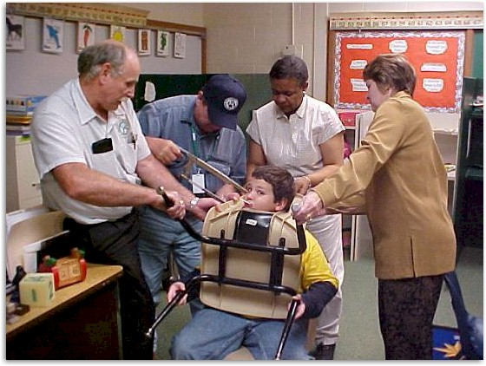
CHOICES HAVE CONSEQUENCES Everyone affected by a decision is a stakeholder in that decision.
Look how many people were affected by this young man’s decision to stick his head through the opening in the back of his chair.
Notes:
Ethics in Public Administration
(c)2006 Josephson Institute
102

Slide 103
Aspects of an Exemplary Decision
Based on sufficient reliable information
Effectively accomplishes the decision-maker’s objectives
Efficient
Avoids unintended consequences
Results in the most good and the least harm to each stakeholder.
Is and appears to be ethical
Generates trust
Treats all stakeholders respectfully
Is fair to all concerned
Demonstrates caring and concern for all stakeholders
Abides by laws and rules
Acknowledges and fulfills the decision-maker’s responsibilities

Slide 104
A5.1 Systematically Analyze the Problem. Students demonstrate the ability to approach situations and problems systematically to determine what course of action will produce the best possible result by determining whether the options they are considering will be:
1) Effective – the action accomplishes desired results efficiently and without unintended consequences that outweigh its benefits.
2) Ethical – the action is legal and consistent with ethical principles and moral duties.
3) Optimal – the action will produce the best possible result in the long run, taking into account divergent and conflicting interests of all the stakeholders in the decision.

Slide 105
A5.2 Employ Decision-Making Strategies. Students understand and employ classic decision-making strategies in complex situations:
1) Role Model Test – do what you think a person you admire for ethics and wisdom would do. (e.g., Mother Teresa, your grandmother)
2) Publicity Rule – only do what you would do if you knew your decision would be known by everyone (e.g., reported on TV news or Facebook)
3) Positive Outcome Test (consequentialism) – when ethical values conflict (e.g., where the truth would be unkind) choose the best possible result by determining which option is most likely to produce the most long-term good and do the least harm for the most people
4) Moral Absolutism (Moral Imperative) standard – on matters involving core ethical convictions, treat ethical obligations as absolute and do nothing that would violate any ethical principle
5) Self-Image Standard – do what is most consistent with your self-image and the way you want to be thought of by others
Notes:
You can use this slide or the next one to discuss tests for making good decisions.

Slide 106
Publicity Test
Role-Model Test
Golden Rule test: Would I want people to do this to me?
The what‐if‐everybody‐did‐this test: Would I like it if everyone else did this?
Tests for Making Good Decisions
Notes:
Go over all tests for making ethical decisions.

Slide 107
DECISION-MAKING
Key Questions | Who are the stakeholders? How can I make a good decision? What strategies can I use to make a good choice?
Supporting Questions | Why should I make good or right decisions? Who/what do I need to think about to make good decisions? Who will be affected by my decision? How can I find out if I’m making a good ethical decision? How can I make better decisions? How can I change the way I make decisions to improve the outcome? What steps should I take to achieve a good result for most stakeholders? How can I help others to make better ethical decisions?
Key Concepts | Stakeholders, thinking, clarifying goals, developing options, effective and ethical decisions, best possible result, consequences

Slide 108
Count off by 4 and create a small group that will work through the following role play at your table.
Jamie is a High School Junior. As part of the science class, Jamie is one member of a cooperative learning group that has to complete a project by the following Monday. Each member of the group has a specific responsibility to complete for the project. The group has decided to work on Friday after school and on Saturday morning to put together the project so it can be completed by the Monday deadline. On Thursday, Jamie is invited by a good friend to a concert on Friday evening. Jamie quickly decides to go. Before leaving on Friday, Jamie meets with the other members of the group to share the decision to go to the concert and that there is no way possible to be in any condition to get up early on Saturday to work on the project. Sunday is out as two other members of the group have family commitments.
In Your Group
The member of your group who has the next birthday plays the role of Jamie. You need to:
Present arguments that explain the choice you have made.
Convey the process used to make the decision to go to the concert.
The other 3 are members of the cooperative learning group. Each will need to :
Respond to Jamie about the choice made.
Who are the stakeholders in his decision?
Discuss what is important in order to accomplish the assigned project.
Share what are the unintended consequences of the choice Jamie has made.
Finally, as a group, discuss what could be a decision that Jamie may make to produce the best possible result.
Notes:
Cooperative group activity.
Break up into groups of 4 with one individual being Jamie (M or F). The remaining individuals are members of the cooperative learning group.

Slide 109
BEST POSSIBLE RESULT (BPR)
Effectively accomplishes the primary objective, in that it solves the immediate problem
Avoids negative unintended consequences
Solves the underlying problem, while providing a broader solution and avoiding future problems
Preserves or advances the decision maker’s relationships
Enhances the decision maker’s credibility

Slide 110
Recognizing Important Decisions
Is there possible danger of physical harm to you or anyone else?
Could you or someone else suffer serious emotional pain?
Could the decision hurt your reputation?
Could the decision impede achieving an important goal?
Could you or someone else suffer significant monetary or property loss?

Slide 111
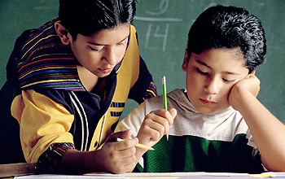
Rule of Universality
Do only those acts which you are willing to allow to become universal standards of behavior applicable to all people in similar situations.
If everyone did it, would it be a good thing?

Slide 112
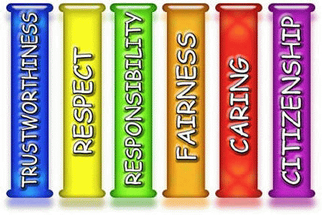
Good decisions are effective and ethical
JI Character-Based Decision-Making Model
1. Ethical decisions take into account the interests and well-being of everyone affected by your actions (stakeholders).
2. Ethical decisions put values of Trustworthiness, Respect, Responsibility, Fairness, Caring, & Citizenship above others.
3. If it is necessary to violate one core ethical value to honor another, do what will produce the greatest good in the long run.
2.
1.
3.
Best in long run

Slide 113
Students have friends in another class with the same teacher. Sara and Julie are best friends and tell each other everything. Sara goes to class first and gets all of the answers for last night's homework. Julie doesn't like history, but didn't finish her homework and asks Sara for help.
Who are the stakeholders in this scenario?
What Pillars is Sara struggling with in deciding how to answer Julie?
What do you think Sara would do?
Give Julie the answers because they are best friends.
Sara can give Julie some of the answers and tell her to finish the homework at lunch.
Tell Julie she can’t help her.
Sara will take time to help Julie complete the homework during lunch, not by giving her the answers but assisting her where she can find them.
Tell Julie it would be cheating if she gave her the answers.
What do you think Sara ought to do? What does Sara have to think about when making her decision?

Slide 114
Video - Honesty

Slide 115
Brian is looking forward to the start of the new school year. Right from the first day, Brian’s good friends are making fun of a new student who has just moved into the neighborhood. They all joke about how he looks and talks. While walking home after school, one of Brian’s friends decides to pick a fight with the new student. Before you know it, others are joining in.
Who are the stakeholders?
What options does Brian have?
What are the potential consequences of his possible choices?
Who else will be impacted by the decision he makes?
What do you think Brian will decide to do?
What do you think Brian should do?

Slide 116
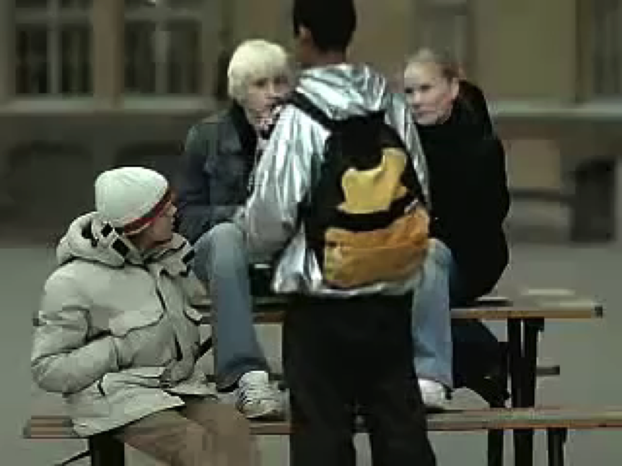
Video - Anti-Bullying
Notes:
https://www.youtube.com/watch?v=nWJut7KQhI4

Slide 117
Kara is a high school freshman. Last weekend, she is arrested by department store security for shoplifting. She had over $30 in her purse, and was trying to steal a blouse for $18. She said that the friends she was with were all swiping things that day, but didn't get caught, and that they were all encouraging her to join in the fun of getting stuff for free.
Why did Kara choose to steal?
In her decision to steal, who are the stakeholders she should have thought of?
What values are in conflict for Kara?
When confronted with a choice of stealing to fit in or doing the right thing, what should Kara think about before making a decision?
What were Kara’s options?
What are the consequences of the various options open to Kara?
What would have been the best decision for Kara? How do you know?

Slide 118
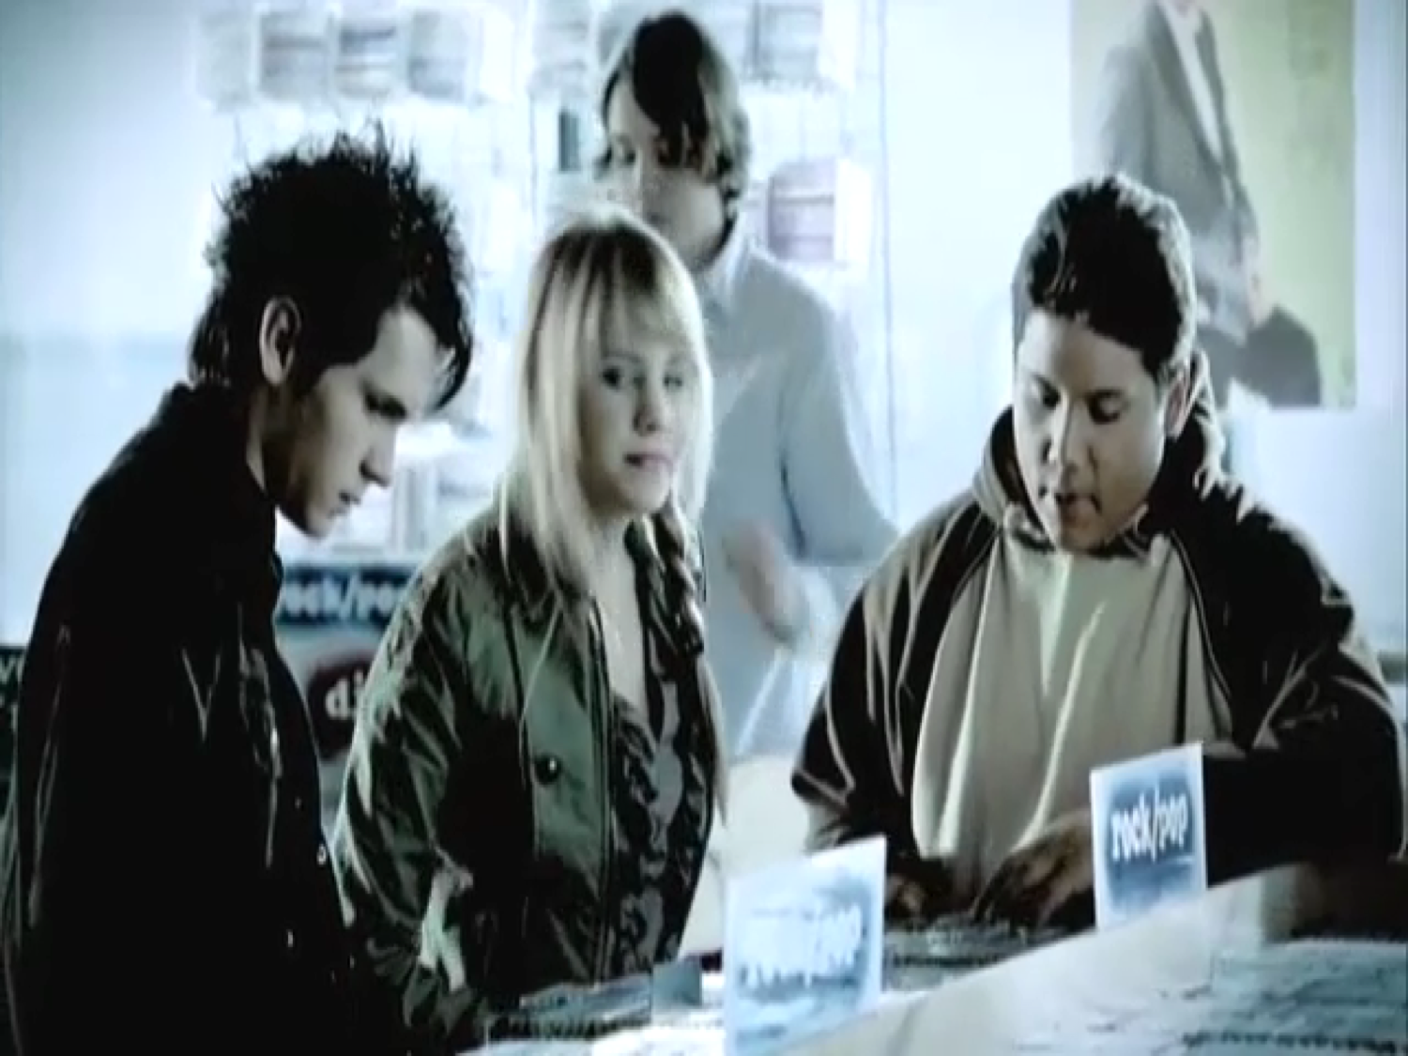
Video - Peer Pressure

Slide 119
Day 2 Homework - Dialogue Presentations
What are the Six Pillars?
What is T.E.A.M.?
Discuss Decision-Making (Stakeholders)
CHARACTER COUNTS! 5.0 Presentation
The 4 Domains
Notes:
Ethics in Public Administration
(c)2006 Josephson Institute
119

